Slide 1





5 Working With Columns
Prepared By :
Said Fawzy
Manager of Information Center
Tendering Department
Arab Contractors

Slide 2

5 Working With Columns
Prepared By :
Said Fawzy
Manager of Information Center
Tendering Department
Arab Contractors

Slide 3

1
Benefits of working with Columns.
2
Manipulating Columns
3
Common Data Errors
4
Data Types

Slide 4
1
Benefits of working with Columns

Slide 5



Benefits of working with Columns

Slide 6
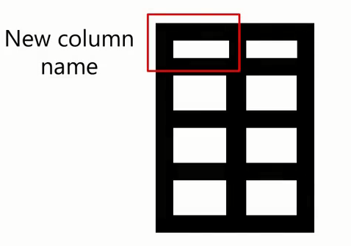



Benefits of working with Columns

Slide 7



Benefits of working with Columns

Slide 8




Benefits of working with Columns

Slide 9


Benefits of working with Columns
Reduce Computational Resources

Slide 10
2
Manipulating Columns

Slide 11
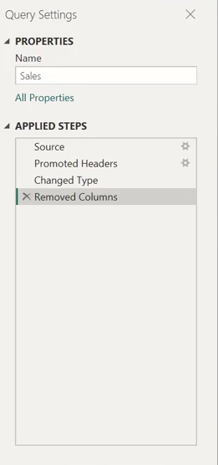
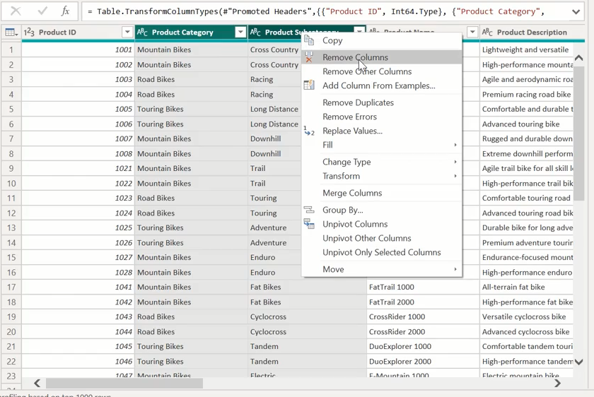
Remove Columns

Slide 12
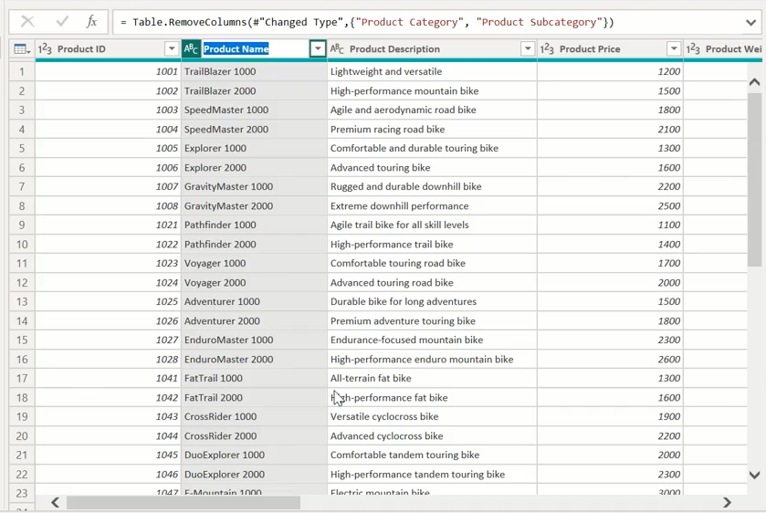
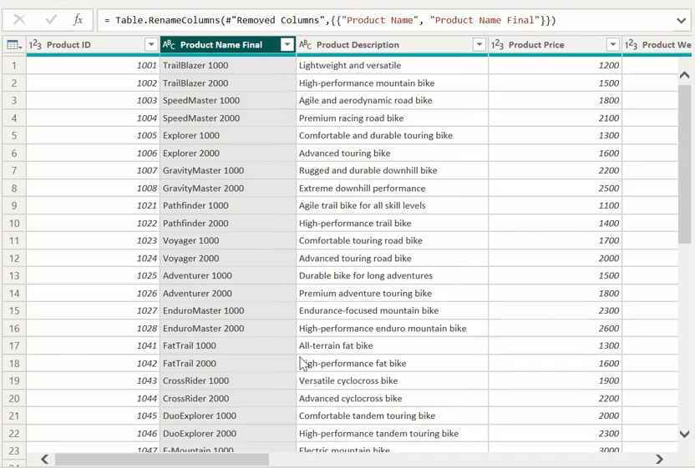
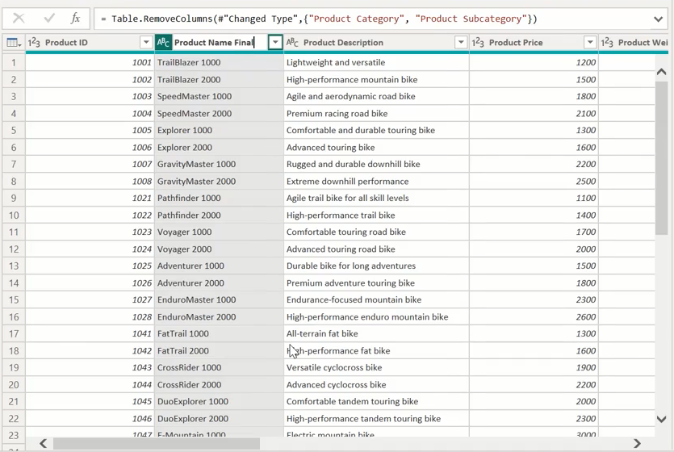
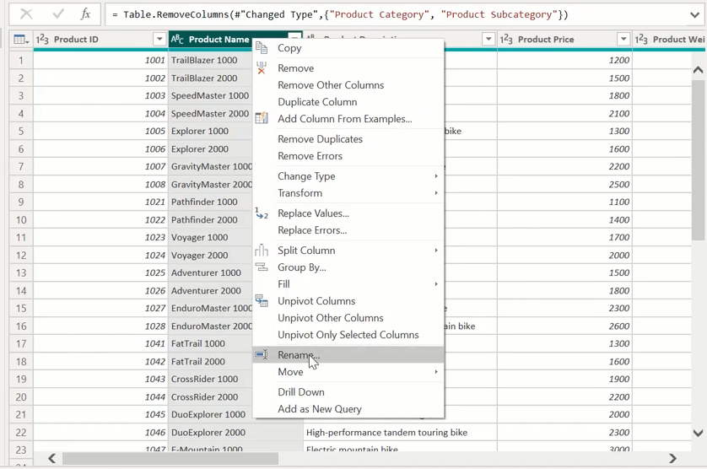
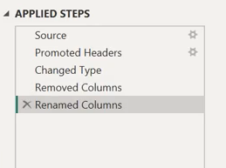
Rename Columns

Slide 13
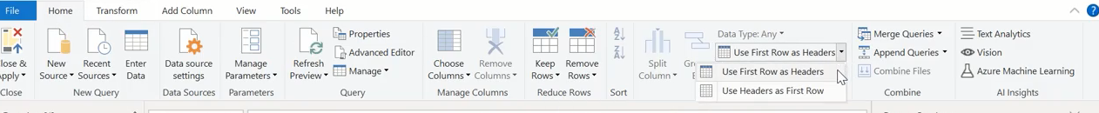
Promote Header Rows

Slide 14
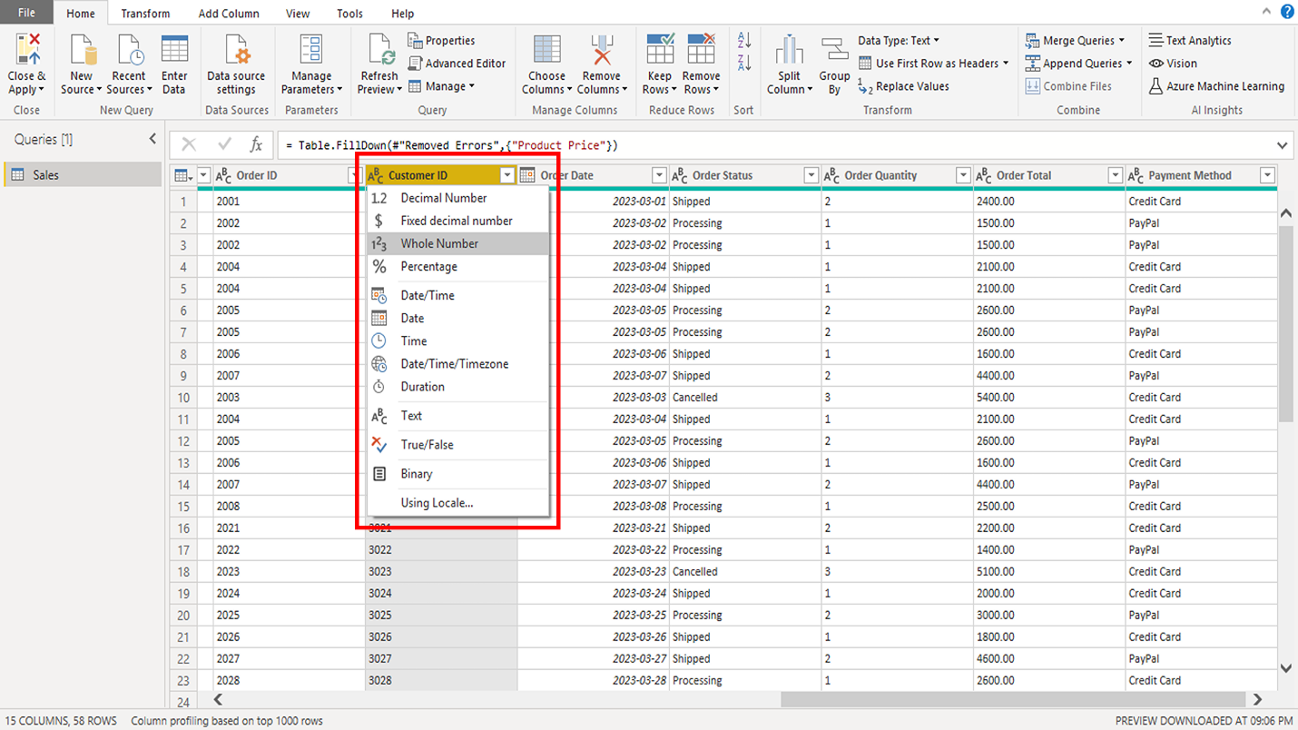
Change a data type

Slide 15
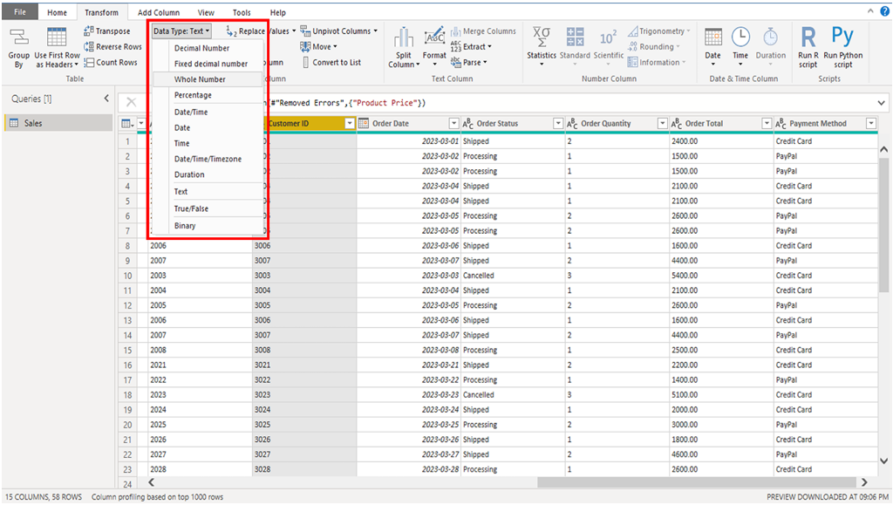
Change a data type

Slide 16
Question
How does removing unnecessary columns from a dataset benefit the data analysis process?
A. It reduces the dataset size, making it easier to manipulate and process.
B. It changes the structure of the dataset entirely.
C. It creates new columns with more relevant data.
D. It makes the dataset look more visually appealing.

Slide 17
ANSWERS
How does removing unnecessary columns from a dataset benefit the data analysis process?
A. It reduces the dataset size, making it easier to manipulate and process.
B. It changes the structure of the dataset entirely.
C. It creates new columns with more relevant data.
D. It makes the dataset look more visually appealing.

Slide 18

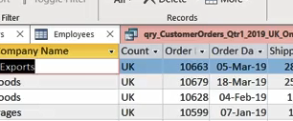
Exercise 7: Connecting to CSV File

Slide 19
Exercise 8: Connect to a Web Page

Slide 20
3
Common Data Errors

Slide 21
Common errors
Missing or null values
Duplicate rows
Inconsistent data types.

Slide 22
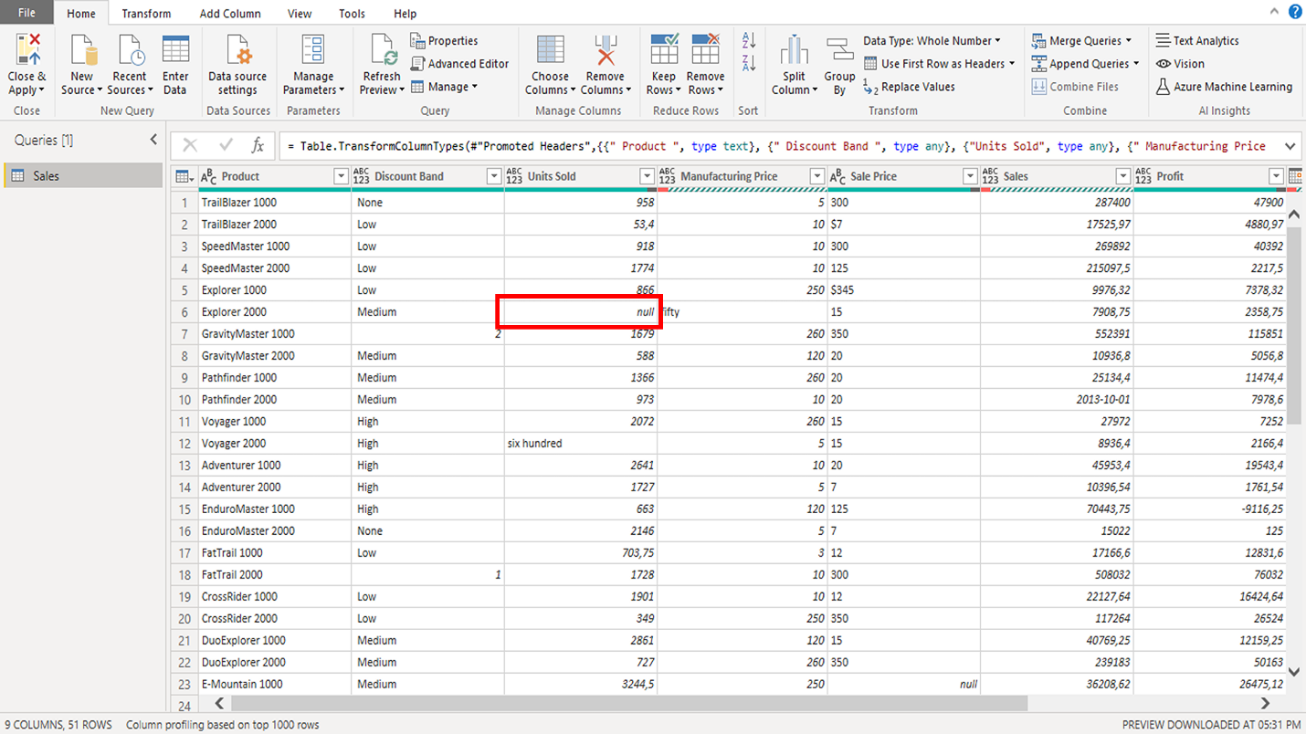
Missing or null values

Slide 23
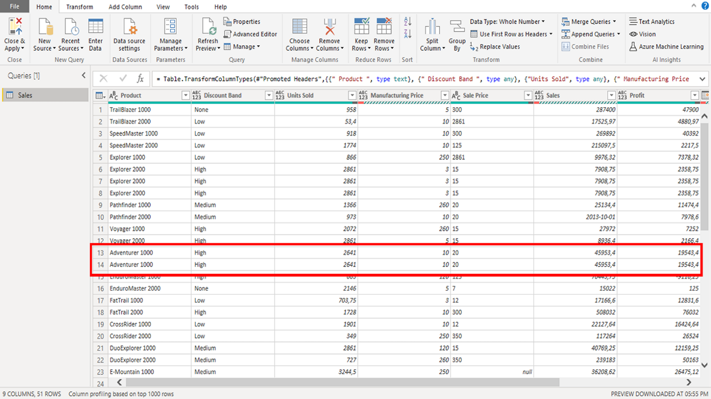
Duplicate rows

Slide 24
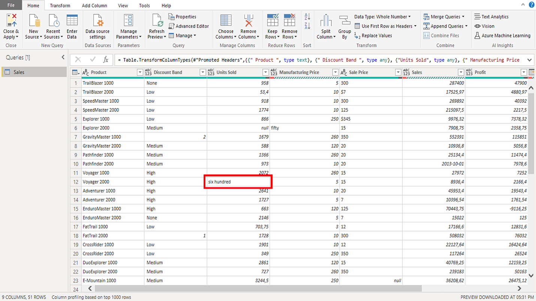
Inconsistent data types

Slide 25
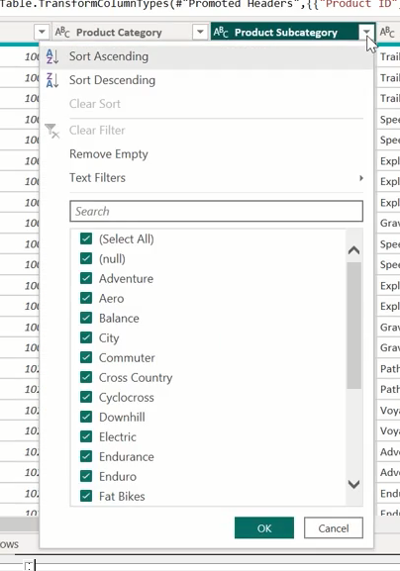
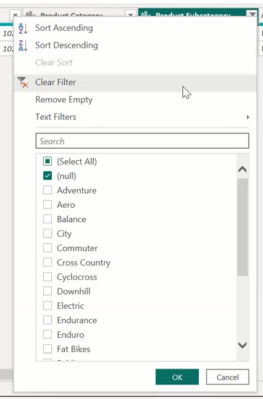
Activity: Dealing with errors in Power Query

Slide 26
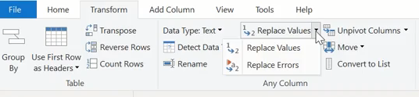
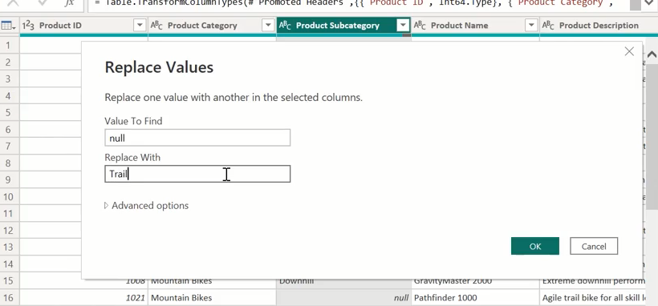
Replace Value

Slide 27
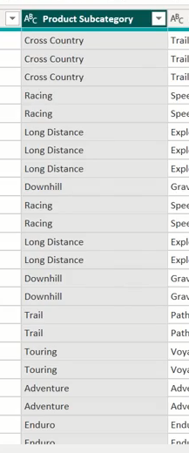
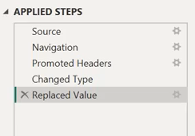
Replace Value

Slide 28
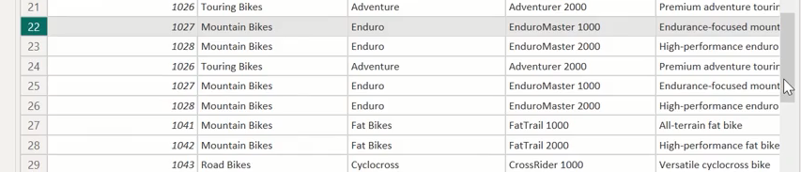
Remove Duplicates

Slide 29
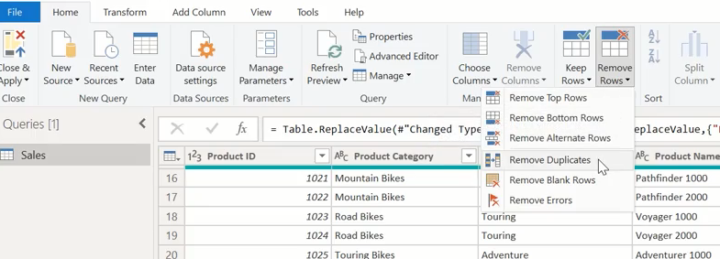
Remove Duplicates

Slide 30
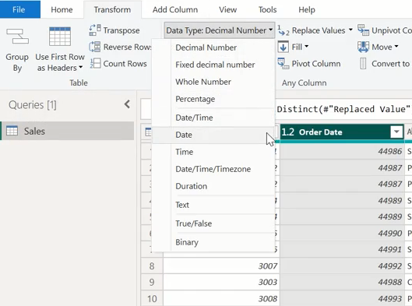
Inconsistent data type

Slide 31
Question
Which of these issues in Power Query within Power BI is related to the presence of empty cells in your dataset?
A. Duplicate rows
B. Missing or null values
C. Inconsistent data types
D. Data entry errors
.

Slide 32
ANSWER
Which of these issues in Power Query within Power BI is related to the presence of empty cells in your dataset?
A. Duplicate rows
B. Missing or null values
C. Inconsistent data types
D. Data entry errors
.

Slide 33
Exercise 9: Extracting Text

Slide 34
Exercise 10: Split Column

Slide 35
Exercise 11: Creating A Conditional Column

Slide 36
Exercise 12: Creating a Column from Examples

Slide 37


Slide 38
Question 1
Several columns in your worksheet contain missing or null values. Which of the following options must you type in the Value to Find field to locate these values?
A. Missing
B. Null
C. 0

Slide 39
ANSWER 1
Several columns in your worksheet contain missing or null values. Which of the following options must you type in the Value to Find field to locate these values?
A. Missing
B. Null
C. 0

Slide 40
Question 2
What steps did you take to address inconsistencies in date columns in your worksheet? Select all that apply.
A. You changed the data type of the column to Text by clicking on the Data Type icon next to the column name.
B. You dropped duplicate rows by selecting Remove Duplicates inside the Remove Rows menu.
C. You changed the data type of the column to Date by clicking on the Data Type icon next to the column name.
D. You replaced any empty values with a default date using the Replace Values tool.

Slide 41
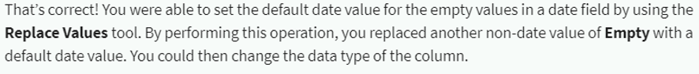
ANSER 2
What steps did you take to address inconsistencies in date columns in your worksheet? Select all that apply.
A. You changed the data type of the column to Text by clicking on the Data Type icon next to the column name.
B. You dropped duplicate rows by selecting Remove Duplicates inside the Remove Rows menu.
C. You changed the data type of the column to Date by clicking on the Data Type icon next to the column name.
D. You replaced any empty values with a default date using the Replace Values tool.
C
D

Slide 42

Question 3
True or false: Once you completed all the data cleaning steps, you clicked Apply or Close & Apply to apply all the transformations you made.
A. False
B. True

Slide 43


